Slide 1
Star Formation through Radio Eyes: Probing Magnetic Fields with CARMA
Chat Hull
University of California, Berkeley
Radio Astronomy Laboratory
26 February 2013
SETI colloquium series
SETI Institute
Mountain View, CA
Notes:
Star formation regions

Slide 2
Outline
Radio astronomy
Electromagnetic spectrum
Interstellar dust and molecules
Looking at radiation from space
Telescopes
Angular resolution & diffraction limit
Single-dish vs. multi-dish array
Polarization with CARMA
Magnetic fields in forming stars

Slide 3
Outline
Radio astronomy
Electromagnetic spectrum
Interstellar dust and molecules
Looking at radiation from space
Telescopes
Angular resolution & diffraction limit
Single-dish vs. multi-dish array
Polarization with CARMA
Magnetic fields in forming stars

Slide 4
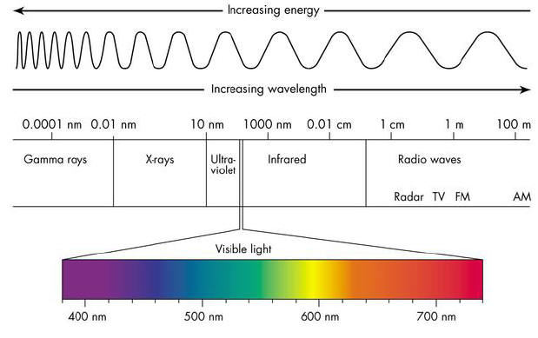
Electromagnetic Spectrum
CARMA
Credit: http://www.antonine-education.co.uk/physics_gcse/Unit_1/Topic_5/em_spectrum.jpg

Slide 5
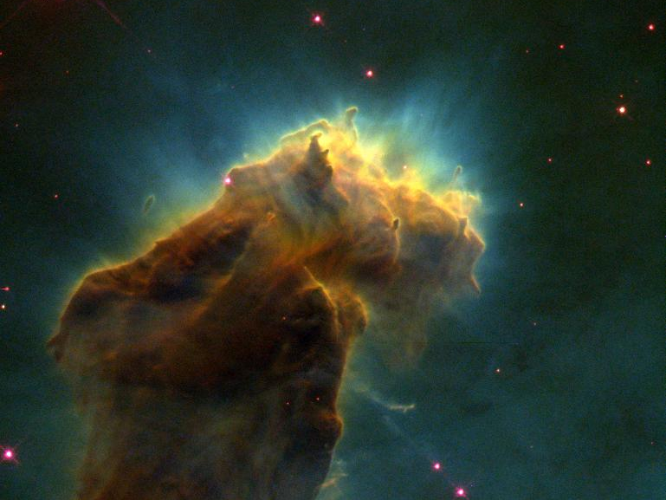
Stars form inside clouds of gas and dust…
0.5 pc
Credit: NASA, ESA, STScI, J. Hester and P. Scowen (Arizona State University)
Notes:
Eagle Nebula (M16)
-There’s actually HIGH-mass SF going on (glowing, evaporating)
-We, however are going to journey inside to look at low-mass forming stars: Class 0s, in particular (rising SED between 2 & 8 microns)

Slide 6
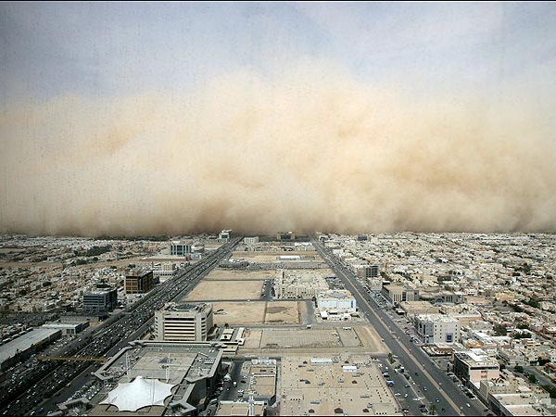
Dust storm over Riyadh
You’re in your car…what do you do?
Credit: thesun.co.uk

Slide 7
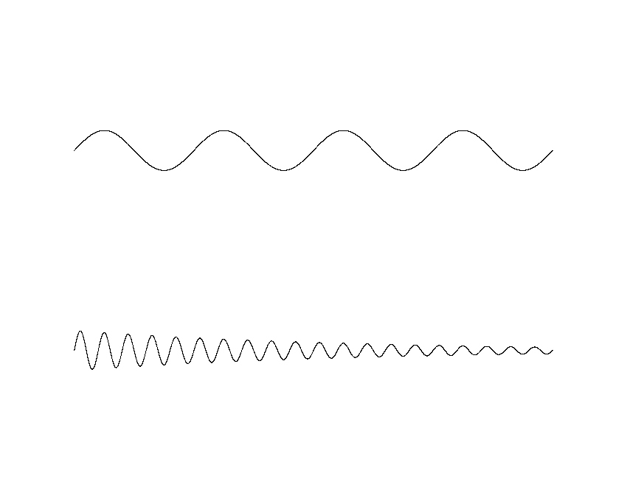
Long wavelengths are much less affected by small particles…

Slide 8
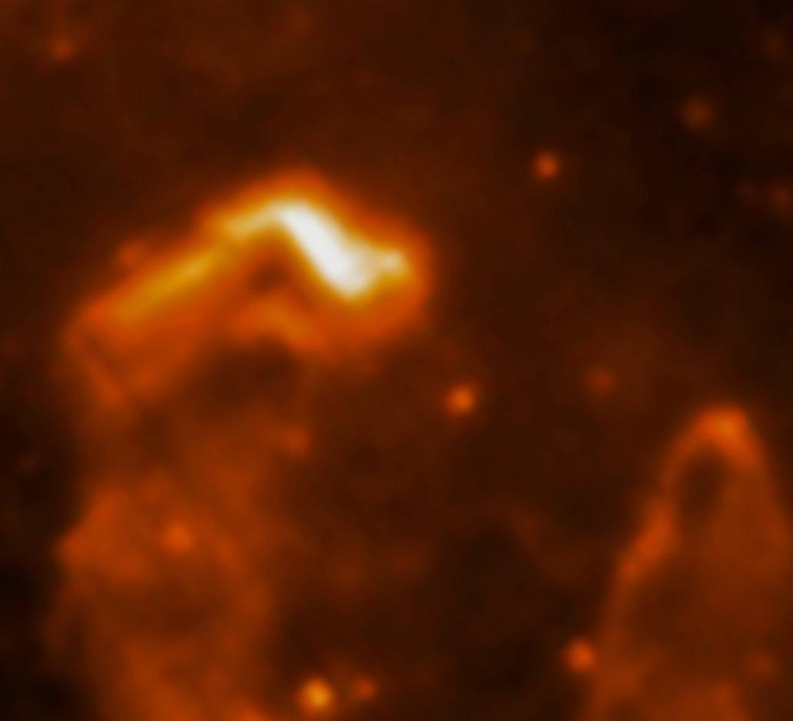
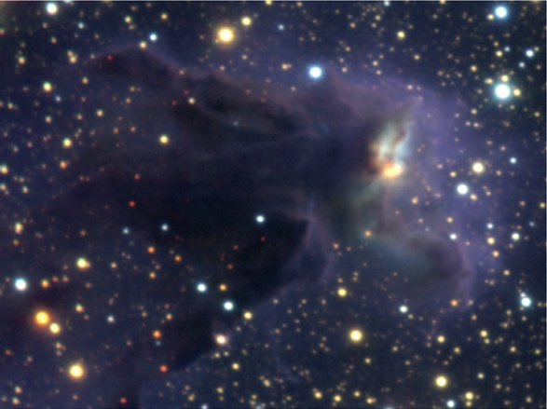
0.5 pc
Credit:
Optical: NASA, ESA, STScI, J. Hester and P. Scowen (Arizona State University)
NIR: ESO/M. McCaughrean & M. Anderson (AIP)
MIR: ESA/Herschel/PACS/SPIRE/Hill, Motte, HOBYS Key Programme Consortium
Notes:
Eagle Nebula (M16)
-There’s actually HIGH-mass SF going on (glowing, evaporating)
-We, however are going to journey inside to look at low-mass forming stars: Class 0s, in particular (rising SED between 2 & 8 microns)

Slide 9
What is an interstellar cloud made of?
hydrogen
(mostly molecular hydrogen, H₂ )
helium
CO, HCN, ...

Slide 10
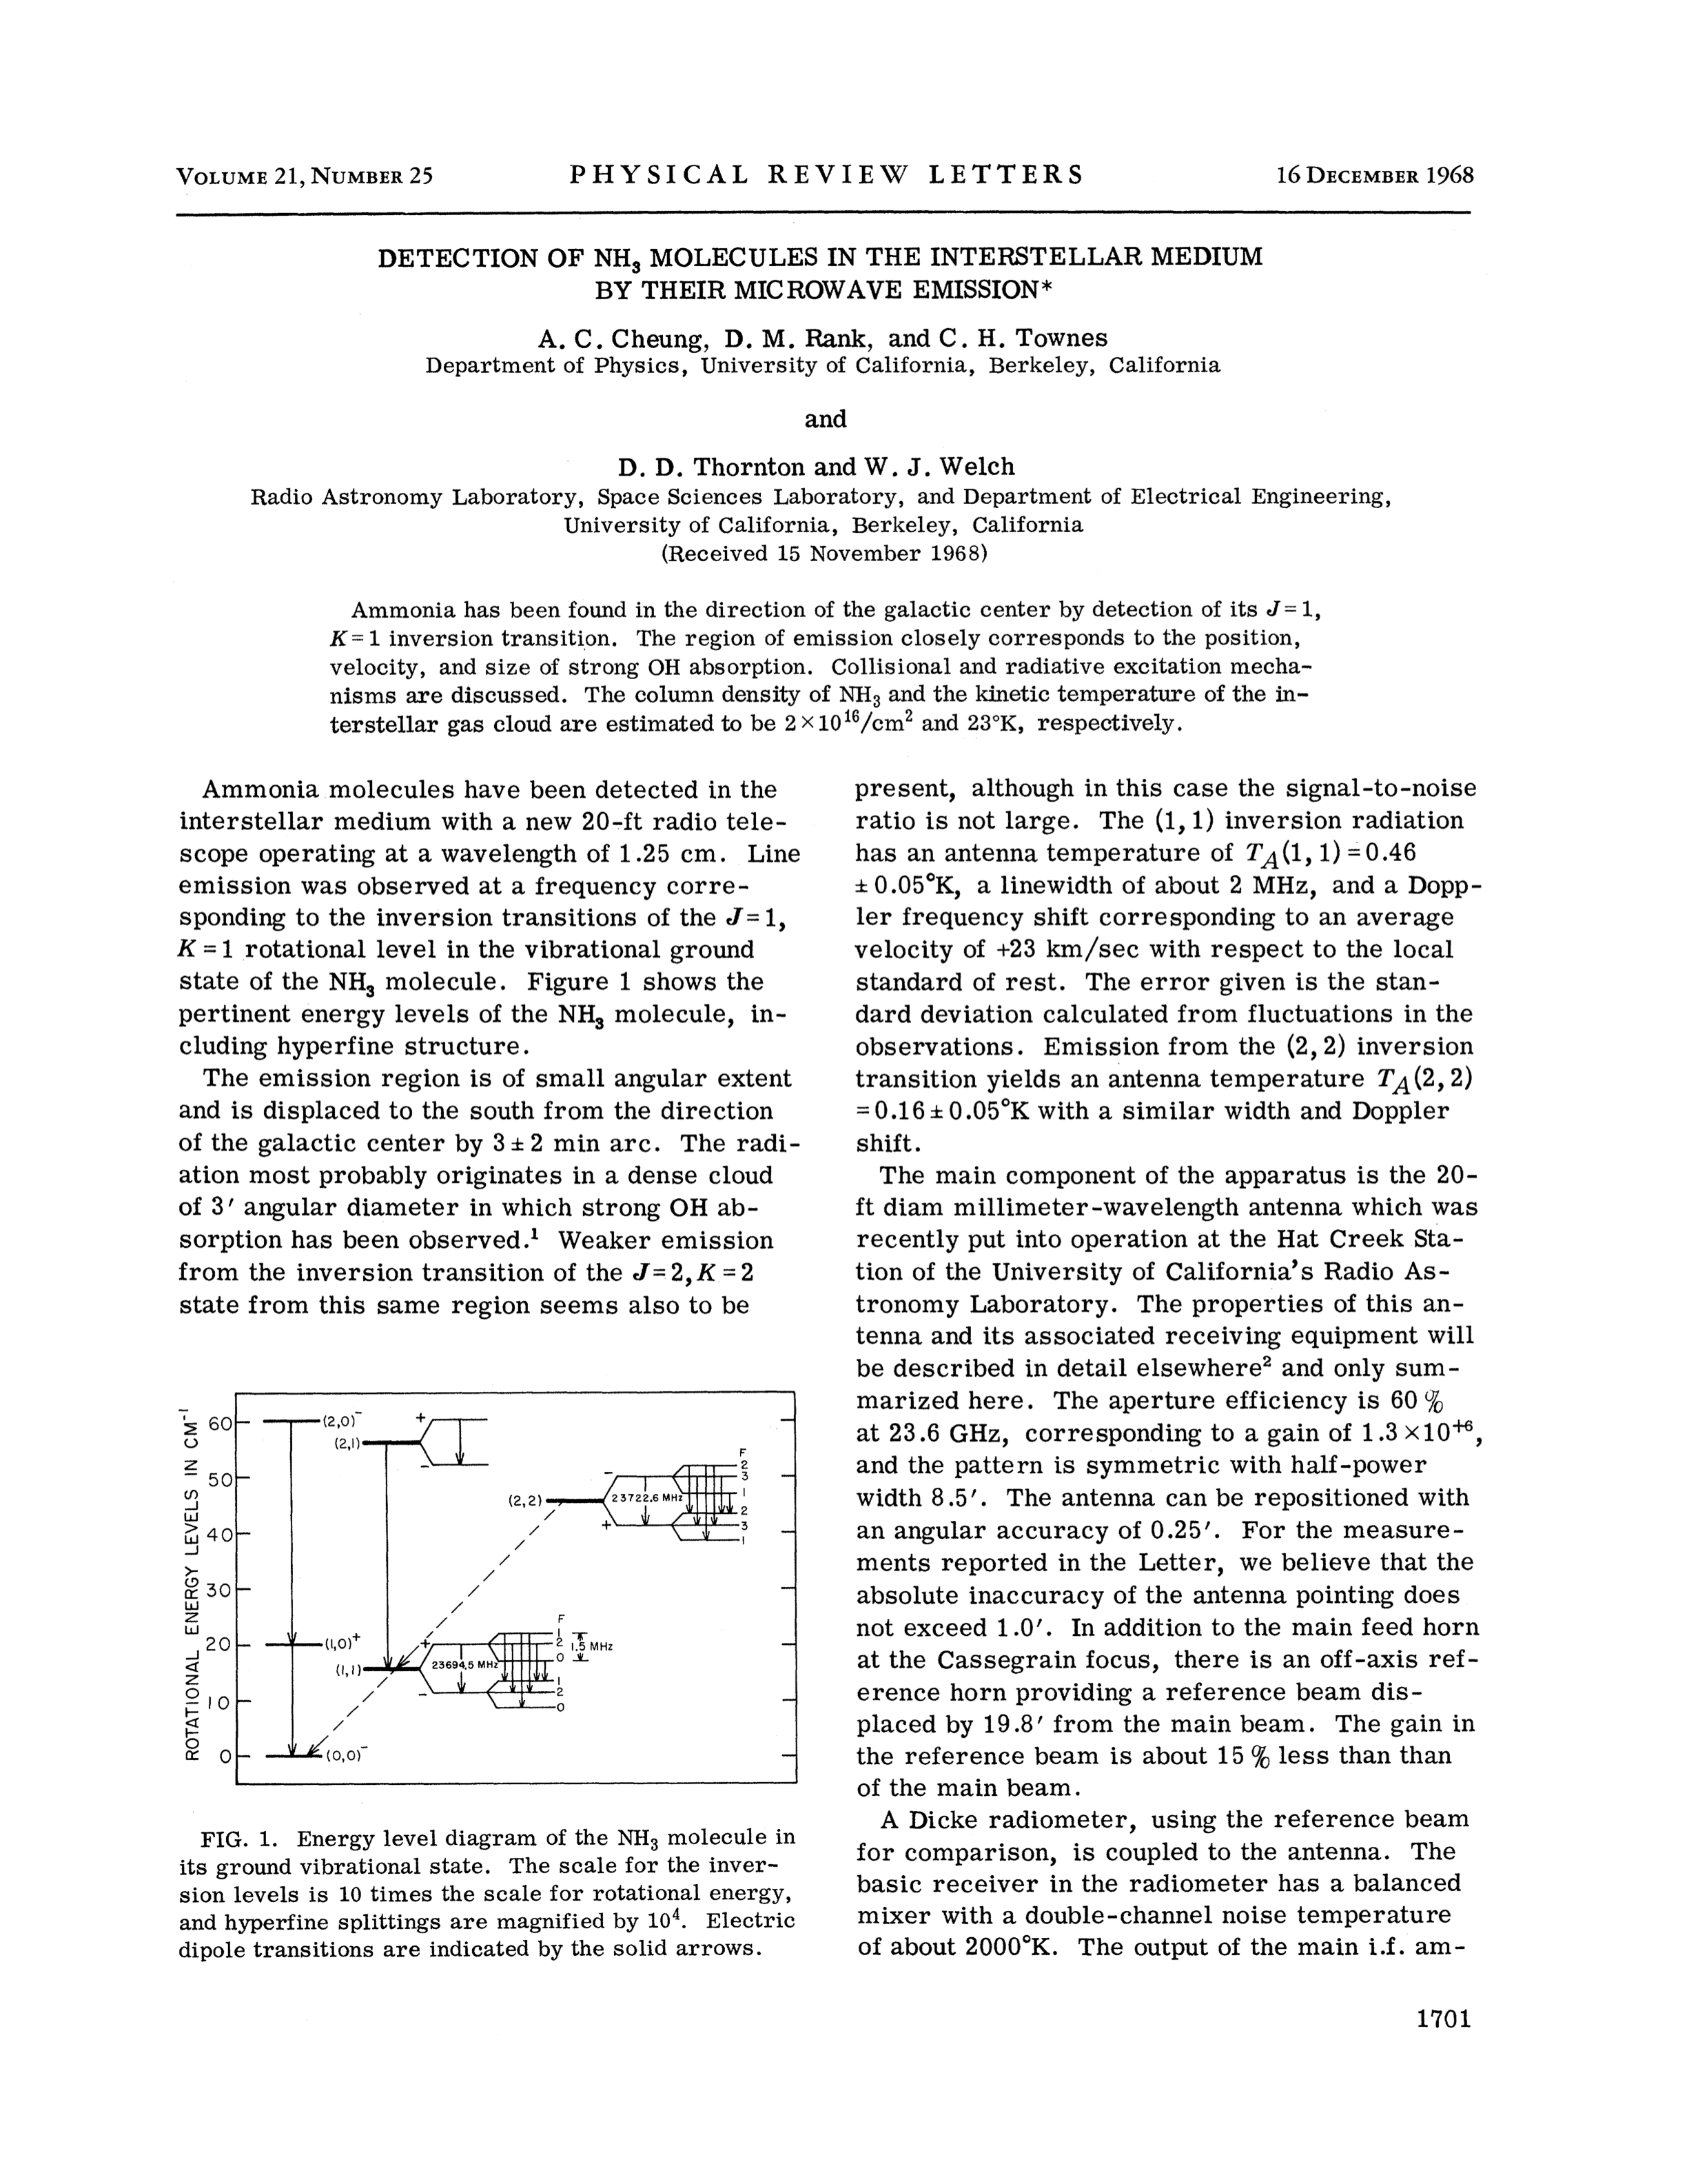
First discovery of trace molecules in an interstellar cloud

Slide 11
Over 120 interstellar molecules now are known
CH, CN, CH⁺, OH, CO, H₂, SiO, CS, SO, SiS, NS, C₂, NO, HCl, NaCl, AlCl, KCl, AlF, PN, SiC, CP, NH, SiN, SO⁺, CO⁺, HF, LiF, SH, FeO, N₂, CF⁺, O₂, H₂O, HCO⁺, HCN, OCS, H₂S, HNC, N₂H⁺, C₂H, SO₂, HDO, HCO, HNO, OCN⁻, HCS⁺, HOC⁺, c-SiC₂, MgNC, C₂S, C₃, CO₂, CH₂, C₂O, NH₂, NaCN, N₂O, MgCH, H₃⁺, SiCN, AlNC, SiNC, NH₃, H₂CO, HNCO, H₂CS, C₃N, HNCS, HOCO⁺, C₃H, C₃O, HCNH⁺, H₃O⁺, C₃S, c-C₃H, C₂H₂, HC₂N, H₂CN, SiC₃, CH₃, HC₃N, HCOOH, CH₂NH, NH₂CN, H₂C₂O, C₄H, SiH₄, c-C₃H₂, CH₂CN, C₅, SiC₄, l-C₃H₂, CH₄, HC₂NC, HNC₃, H₂COH⁺, C₄H⁻, CH₃OH, CH₃CN, NH₂HCO, CH₃CHO, C₂H₄, C₅H, CH₂CHO, HC₃NH⁺, C₅N, H₂COH⁺, C₄H⁻, C₄H₂, HC₄N, c-C₂H₃O, CH₂CNH, CH₃NH₂, CH₂CHCN, CH₃C₂H, HC₅N, C₆H, c-C₂H₄O, CH₂CHOH, C₆H⁻, CH₃C₃N, C₇H, CH₃COOH, CH₂OHCHO, C₆H₂, CH₂CHCHO, CH₂CCHCN, CH₃OCH₃, C₂H₅OH, CH₃CH₂CN, HC₇N, CH₃C₄H, C₈H, CH₃CONH₂, (CH₃)₂CO, NH₂CH₂COOH, CH₃C₅N, HC₉N, HOCHC₂CH₂OH, CH₃C₆H, C₆H₆, CO(CH₂OH)₂, HC₁₁N

Slide 12
Including...
CH, CN, CH⁺, OH, CO, H₂, SiO, CS, SO, SiS, NS, C₂, NO, HCl, NaCl, AlCl, KCl, AlF, PN, SiC, CP, NH, SiN, SO⁺, CO⁺, HF, LiF, SH, FeO, N₂, CF⁺, O₂, H₂O, HCO⁺, HCN, OCS, H₂S, HNC, N₂H⁺, C₂H, SO₂, HDO, HCO, HNO, OCN⁻, HCS⁺, HOC⁺, c-SiC₂, MgNC, C₂S, C₃, CO₂, CH₂, C₂O, NH₂, NaCN, N₂O, MgCH, H₃⁺, SiCN, AlNC, SiNC, NH₃, H₂CO, HNCO, H₂CS, C₃N, HNCS, HOCO⁺, C₃H, C₃O, HCNH⁺, H₃O⁺, C₃S, c-C₃H, C₂H₂, HC₂N, H₂CN, SiC₃, CH₃, HC₃N, HCOOH, CH₂NH, NH₂CN, H₂C₂O, C₄H, SiH₄, c-C₃H₂, CH₂CN, C₅, SiC₄, l-C₃H₂, CH₄, HC₂NC, HNC₃, H₂COH⁺, C₄H⁻, CH₃OH, CH₃CN, NH₂HCO, CH₃CHO, C₂H₄, C₅H, CH₂CHO, HC₃NH⁺, C₅N, H₂COH⁺, C₄H⁻, C₄H₂, HC₄N, c-C₂H₃O, CH₂CNH, CH₃NH₂, CH₂CHCN, CH₃C₂H, HC₅N, C₆H, c-C₂H₄O, CH₂CHOH, C₆H⁻, CH₃C₃N, C₇H, CH₃COOH, CH₂OHCHO, C₆H₂, CH₂CHCHO, CH₂CCHCN, CH₃OCH₃, C₂H₅OH, CH₃CH₂CN, HC₇N, CH₃C₄H, C₈H, CH₃CONH₂, (CH₃)₂CO, NH₂CH₂COOH, CH₃C₅N, HC₉N, HOCHC₂CH₂OH, CH₃C₆H, C₆H₆, CO(CH₂OH)₂, HC₁₁N
hydrogen cyanide
sodium chloride
formaldehyde
formic acid
methanol
ethylene glycol
ethyl alcohol

Slide 13
Radio waves from molecules
Molecules tumble through space
Rotational energies are quantized
A molecule emits a radio wave at a very specific frequency when it drops from one energy level to the next
J = 2
C
O
230,537.99 MHz
(1.3 mm wavelength)
J = 1
O
C

Slide 14
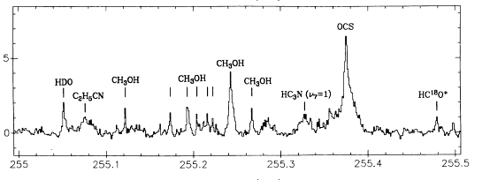
Example radio spectrum (toward the Orion Nebula)
Intensity
Frequency (GHz)
Blake et al. 1986, ApJ, 60, 357

Slide 15
Doppler shifts
230,538.76 MHz
1 km/sec
C
O
230,537.99 MHz
C
O
230,537.22 MHz
1 km/sec
C
O

Slide 16
CO in M51
intensity
velocity

Slide 17
What is an interstellar cloud made of?
hydrogen
(mostly molecular hydrogen, H₂ )
helium
CO, HCN, ...
dust!

Slide 18
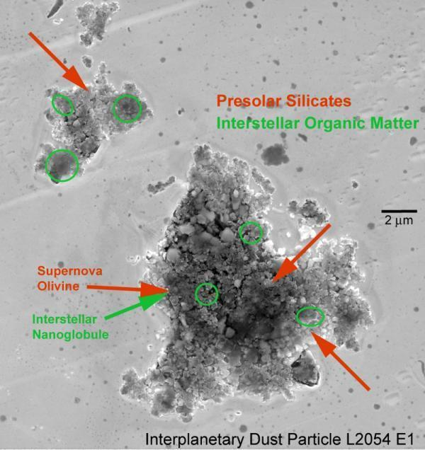
Interstellar Dust
credit:
Credit: H. Busemann,
U. of Manchester

Slide 19
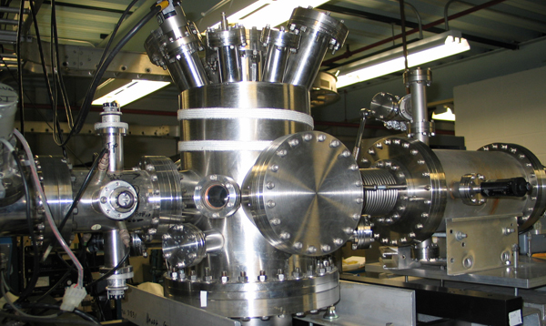
A “dense” interstellar cloud = ultra-high vacuum on Earth!
Photo: Oak Ridge National Lab

Slide 20
Outline
Radio astronomy
Electromagnetic spectrum
Interstellar dust and molecules
Looking at radiation from space
Telescopes
Angular resolution & diffraction limit
Single-dish vs. multi-dish array
Polarization with CARMA
Magnetic fields in forming stars

Slide 21
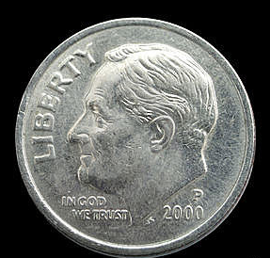
Angular Resolution
If you viewed our solar system from a distance of 400 light years, Saturn’s orbit would be like looking at a dime, 15 miles away!
1 light year = distance light can travel in a year (6 trillion miles!)

Slide 22
Diffraction Limit
λ = wavelength
D = telescope diameter
To see a dime 15 miles away:
 | λ | D
optical | 0.0005 mm | 25 inches
radio | 1.3 mm | 1 mile

Slide 23
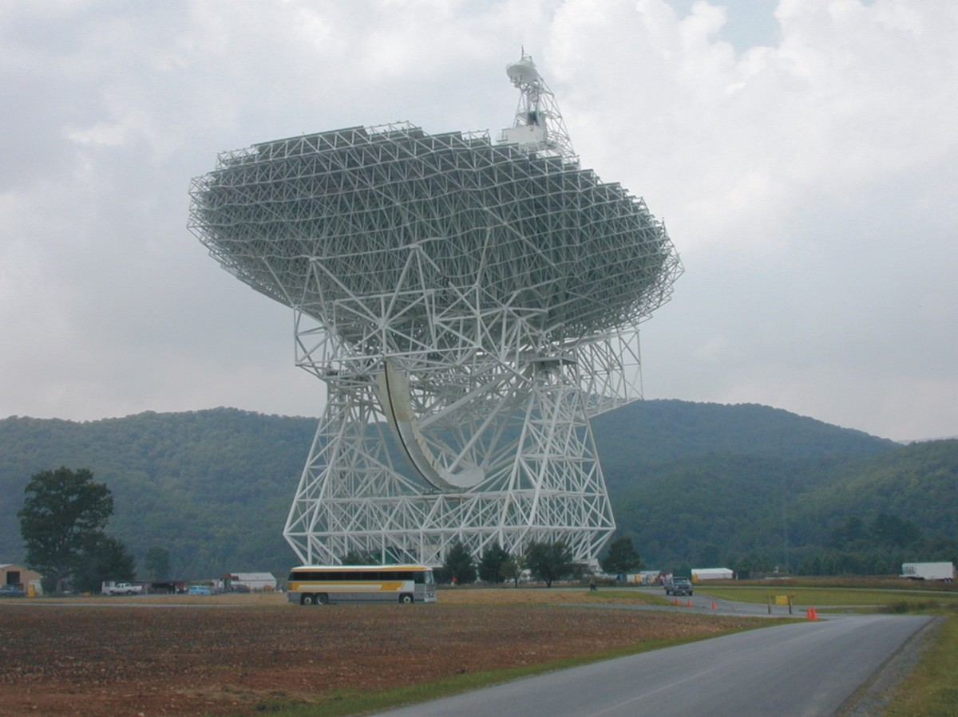
Robert C. Byrd telescope
Green Bank, WV
D = 100 meters
Credit: NRAO / AUI

Slide 24
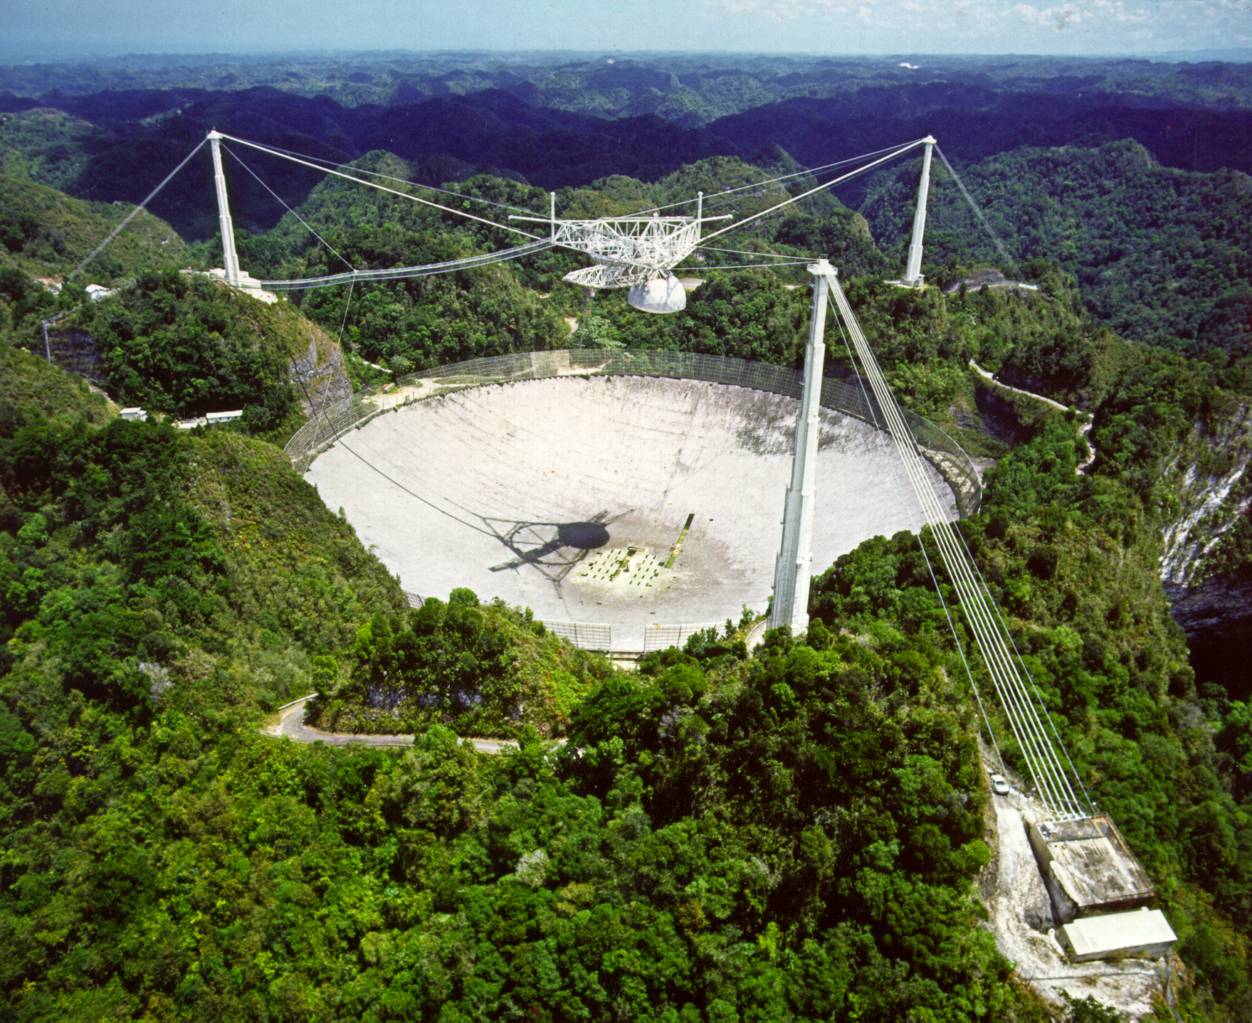
Arecibo Observatory, Puerto Rico
D = 305 m
Credit: http://nerd-alert.net/wp-content/uploads/2011/04/Arecibo_Observatory.jpg

Slide 25
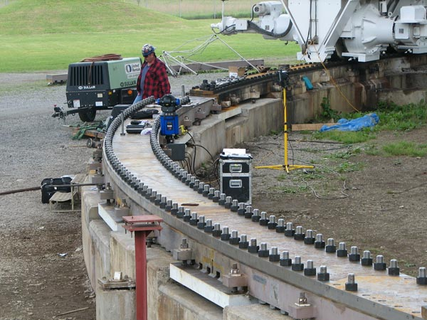
GBT track replacement, 2007
photo: NRAO

Slide 26
D
D
computer
Single-dish telescope
Aperture-synthesis telescope

Slide 27
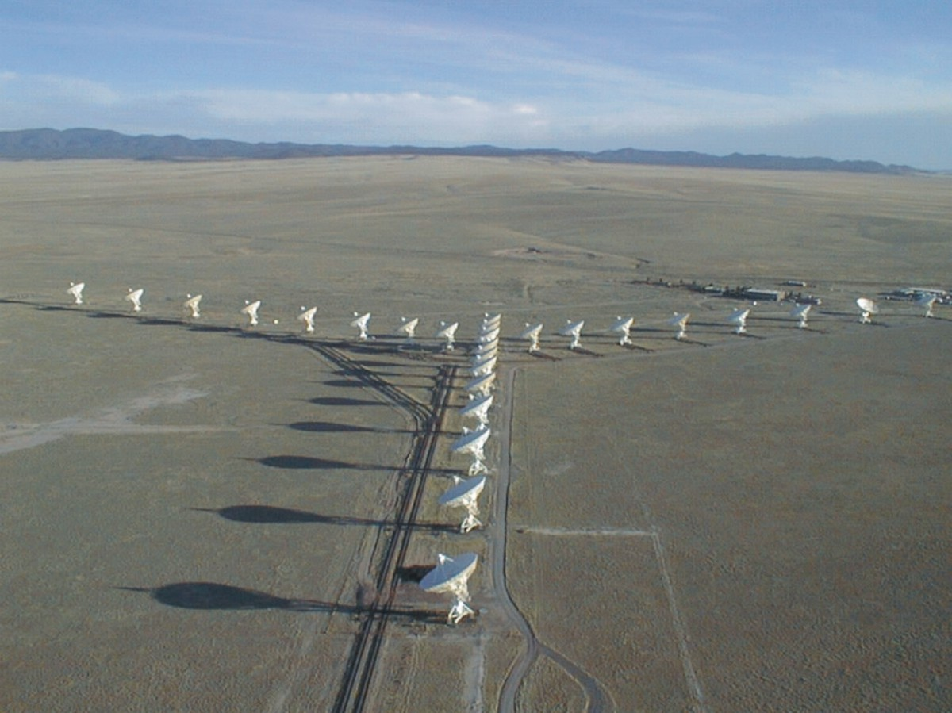
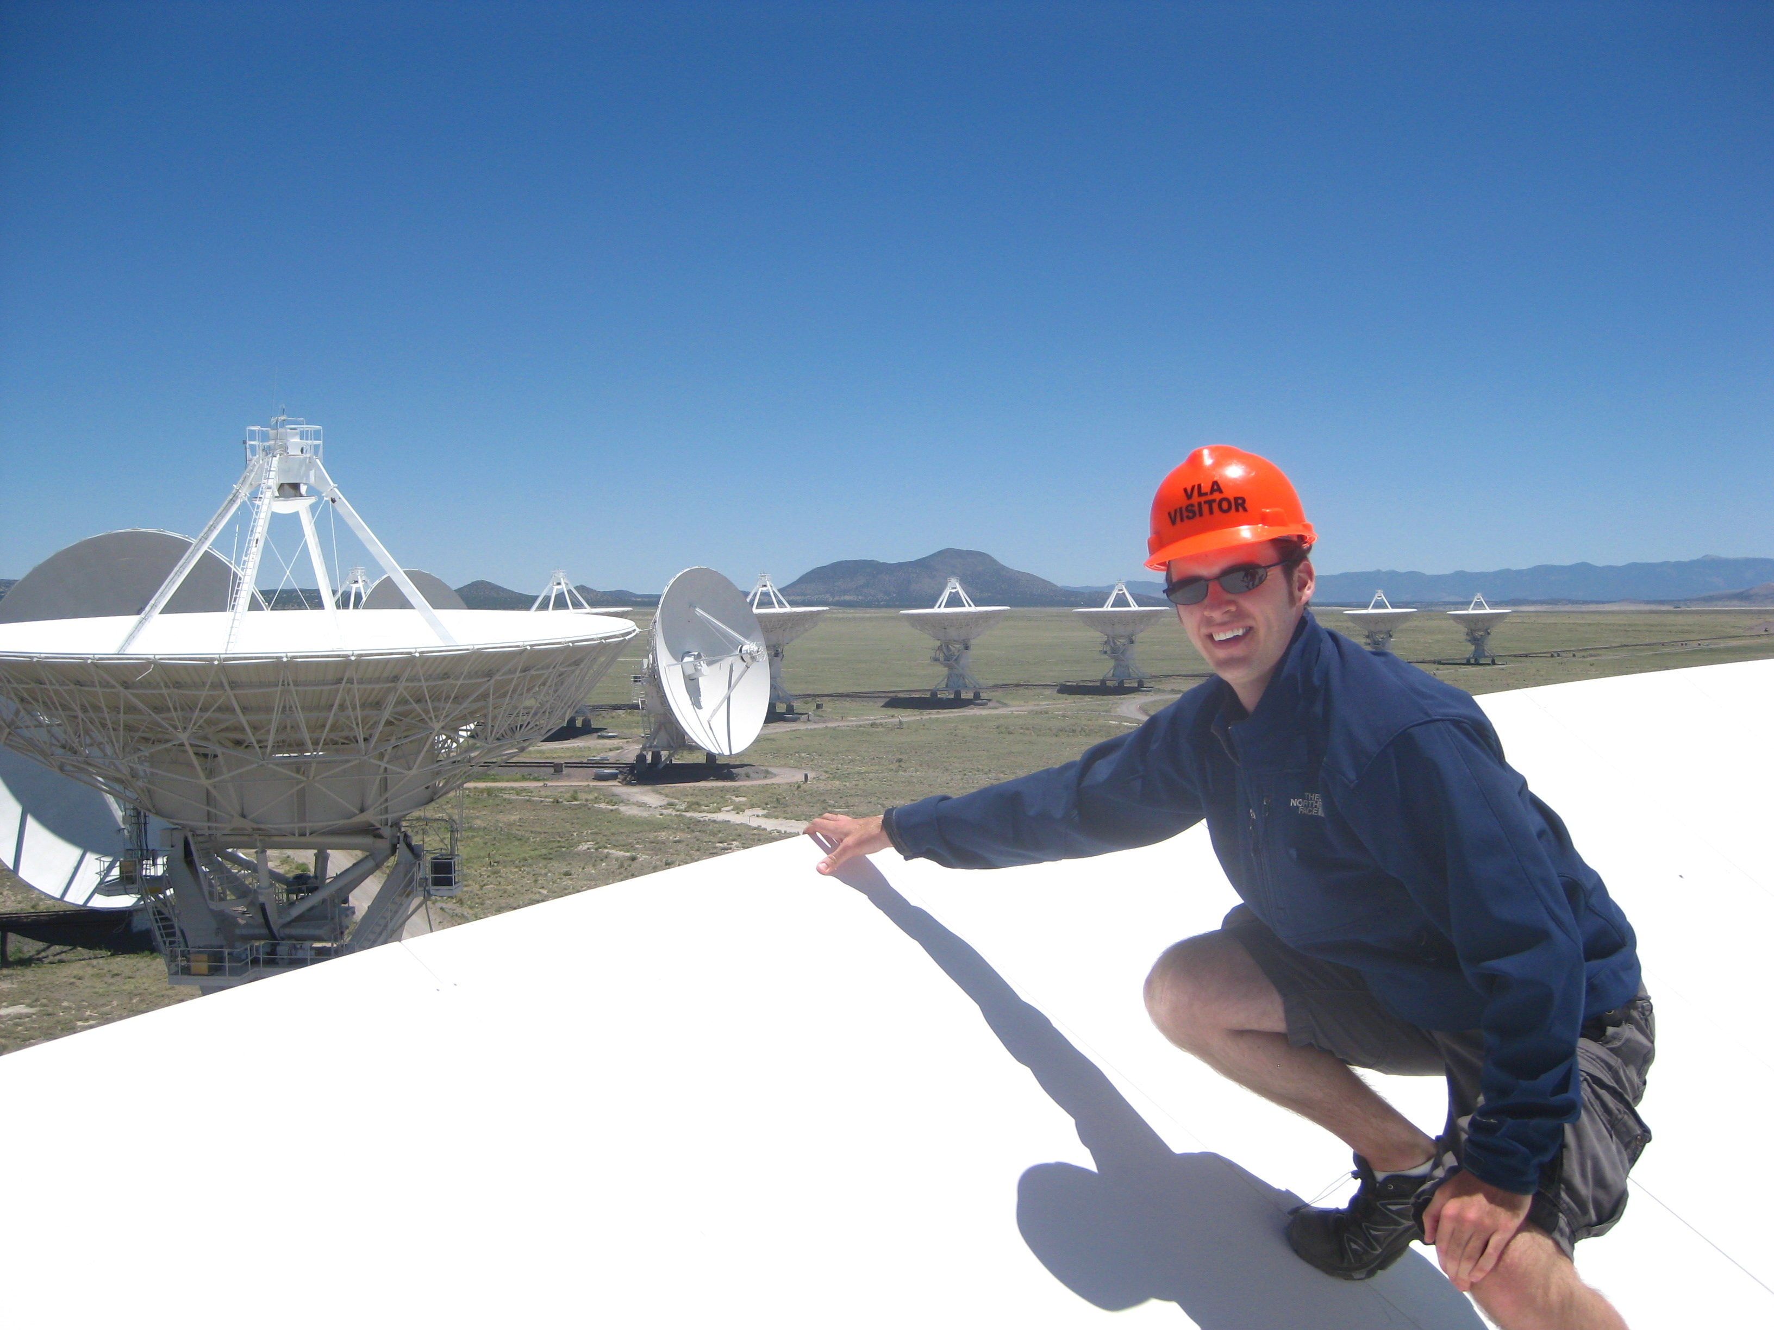
VLA
Credit: Dave Finley / NRAO / AUI

Slide 28
Outline
Radio astronomy
Electromagnetic spectrum
Interstellar dust and molecules
Looking at radiation from space
Telescopes
Angular resolution & diffraction limit
Single-dish vs. multi-dish array
Polarization with CARMA
Magnetic fields in forming stars

Slide 29
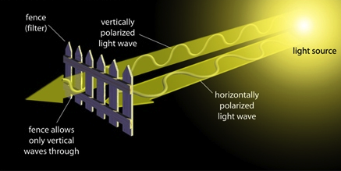
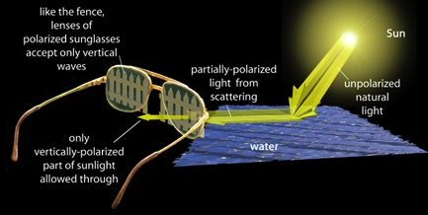
Polarization
Credit: http://primaryeyecare2.files.wordpress.com/2009/03/polarization.jpg

Slide 30
Interstellar Dust
credit:
Credit: H. Busemann,
U. of Manchester

Slide 31
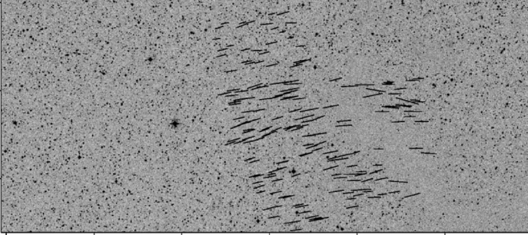
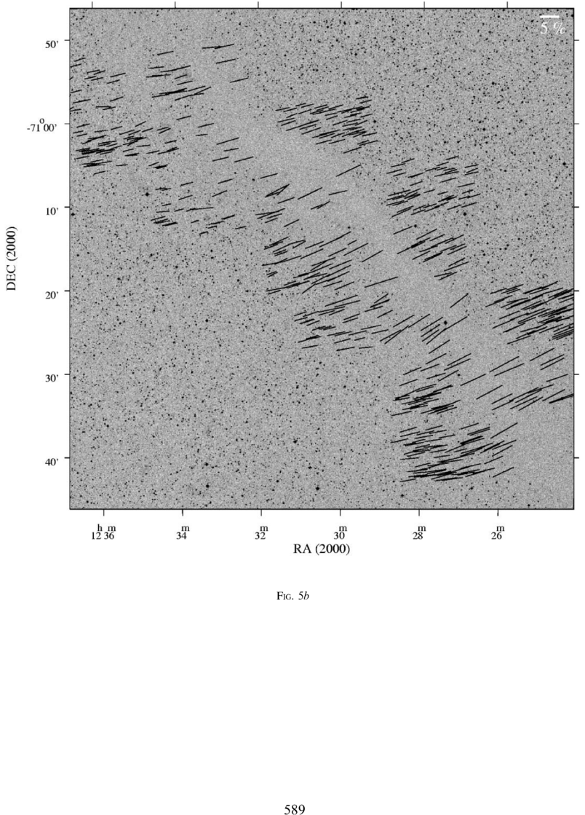
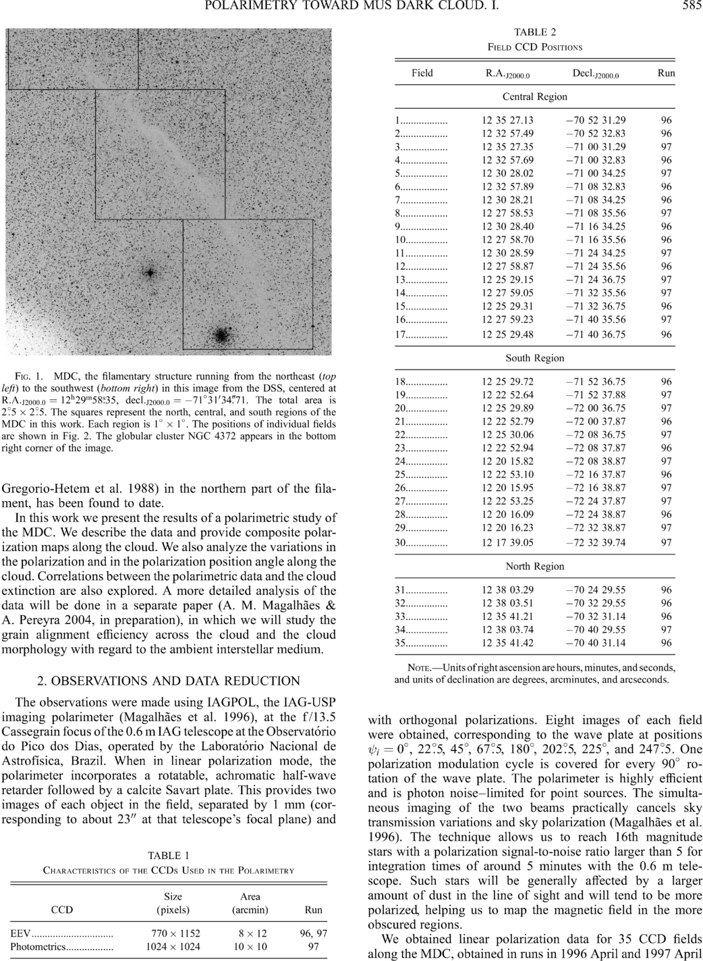
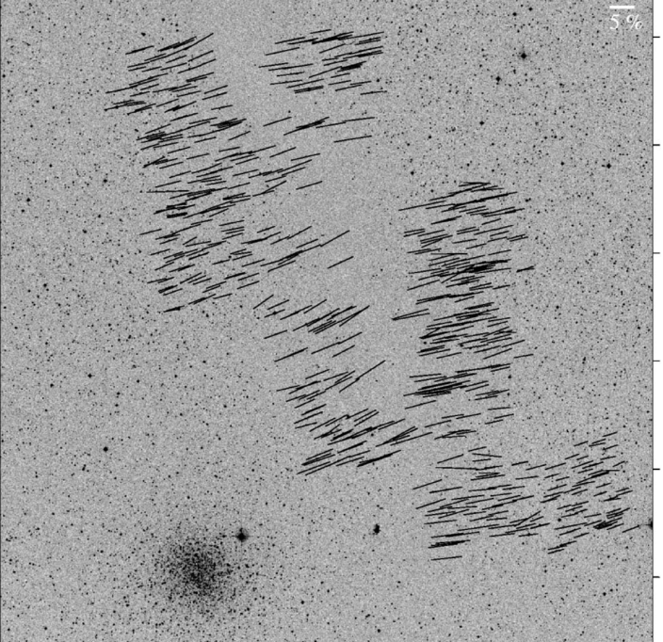
Large-scale: ordered fields
Musca dark cloud
2.5 degrees
E,B
Credit: Pereyra & Magalhães 2004
Notes:
-Distance: 250 pc
-Mass: 250 solar masses
-Length ~10 pc

Slide 32
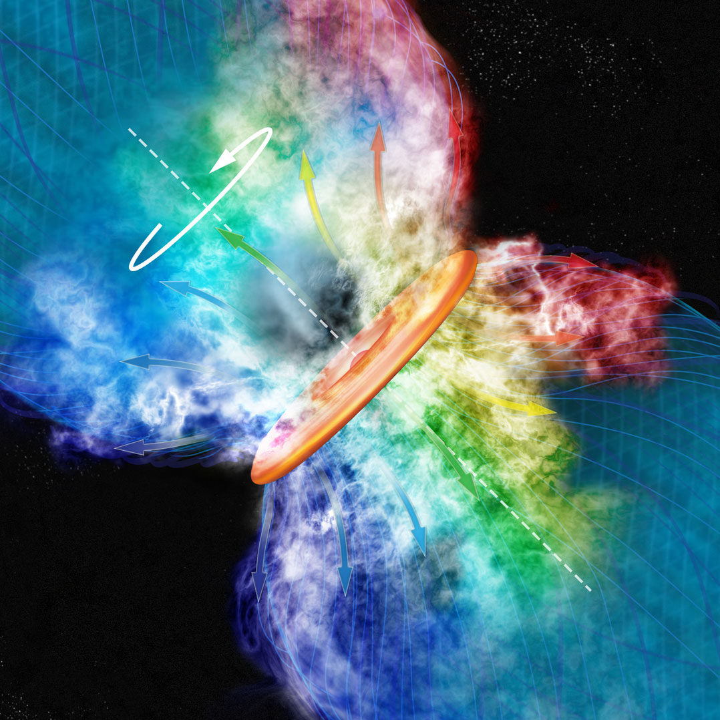
Artist’s conception of an outflow from a massive star
Credit: Bill Saxton, Harvard-Smithsonian Center for Astrophysics

Slide 33
Misalignment of B-fields and outflows
IRAS 4A
VLA 1623
IRAS 16293
Rao+ 2009
Holland+ 1996
Outflow
B-field
Girart+ 2006
Notes:
ROTATION: IRAS 16293 has rot/grav < 0.1; IRAS4A seems the same (barely any rotation); VLA 1623 questionable (probably slow)
-Holland: JCMT data
-Rao, Girart: SMA
-This is okay, according to Hennebelle & Ciardi ‘09 (easier to form disks with obliquity!)
-Ward-Thompson et al (2009) saw a 30 deg offset between short axes of cores and their polarization directions…another problem!

Slide 34
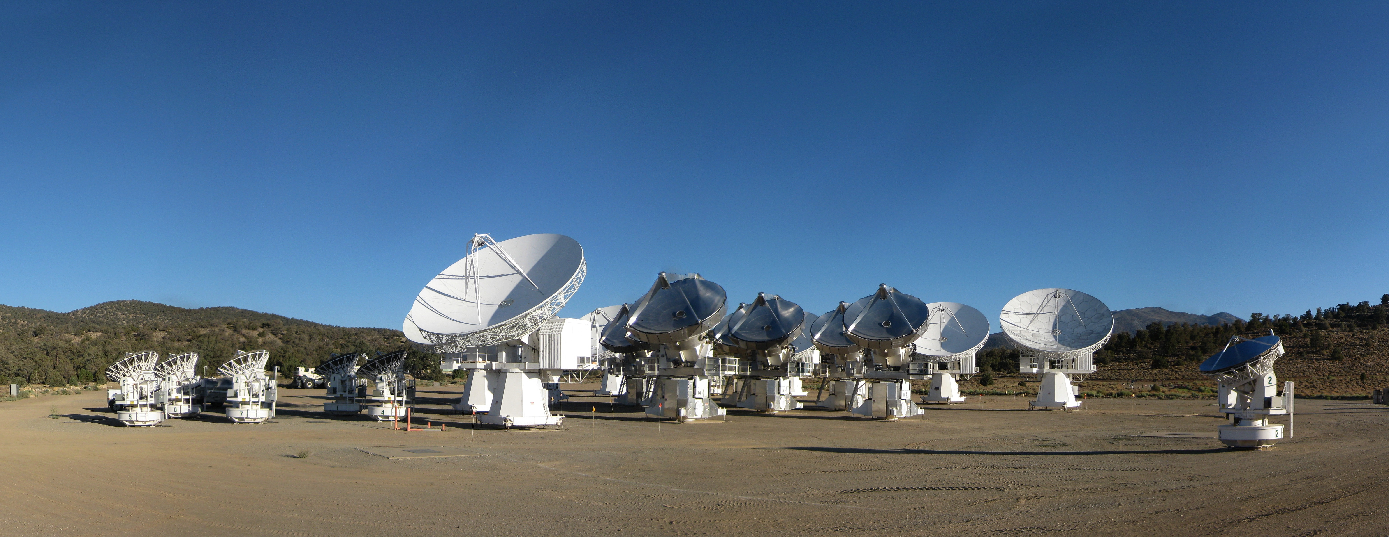
CARMA Combined Array for Research in Millimeter-wave Astronomy Consortium: Berkeley, Caltech, Illinois, Maryland, Chicago
6 ⨯10-m, 9 ⨯ 6-m, 8 ⨯ 3.5-m telescopes
Observations at 1 cm, 3 mm, and 1 mm (polarization!)
Located in Cedar Flat, CA (near Bishop)
Science goals:
Molecular emission in galaxies
Galaxy clusters
Protoplanetary debris disks
Dust polarization in star-forming regions
Notes:
SMA: 8*6m antennas = 226 m^2
CARMA: 6*10m, 9*6m = 726 m^2 (more than factor of 3 more area)
-Factor of two more dishes
-Equivalent T_sys?

Slide 35
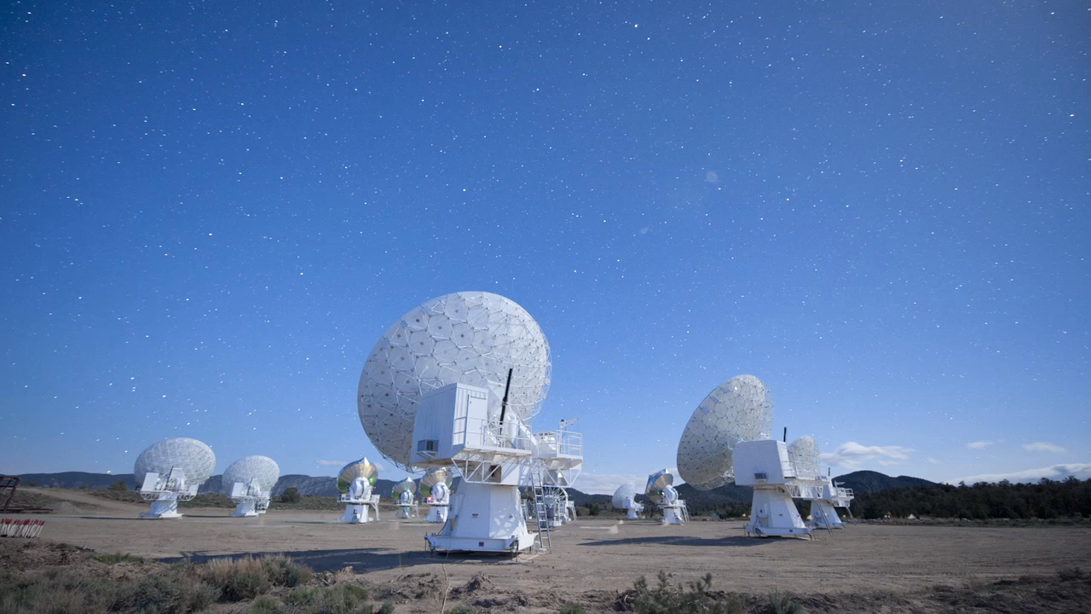
CARMA in stop-motion

Slide 36
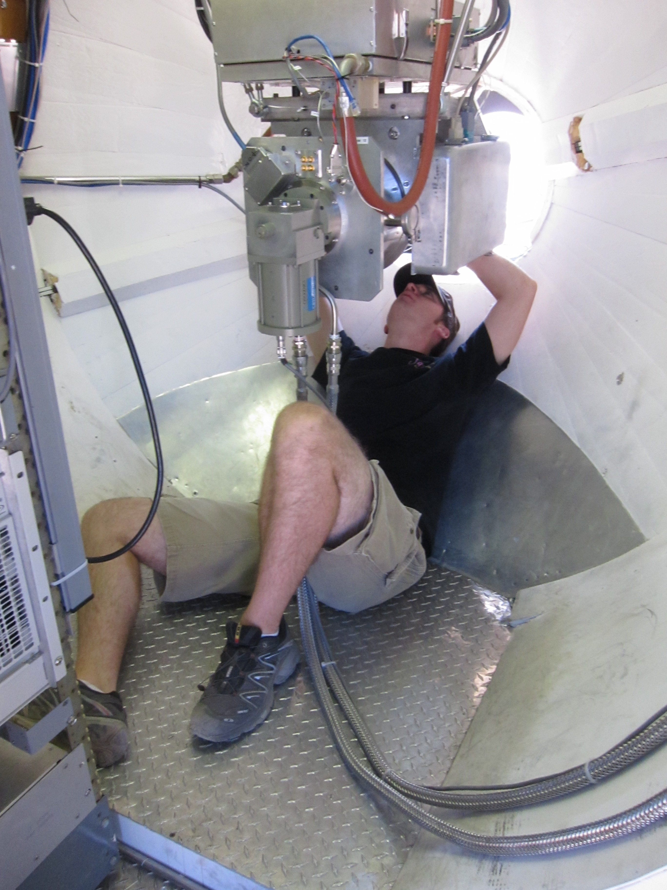
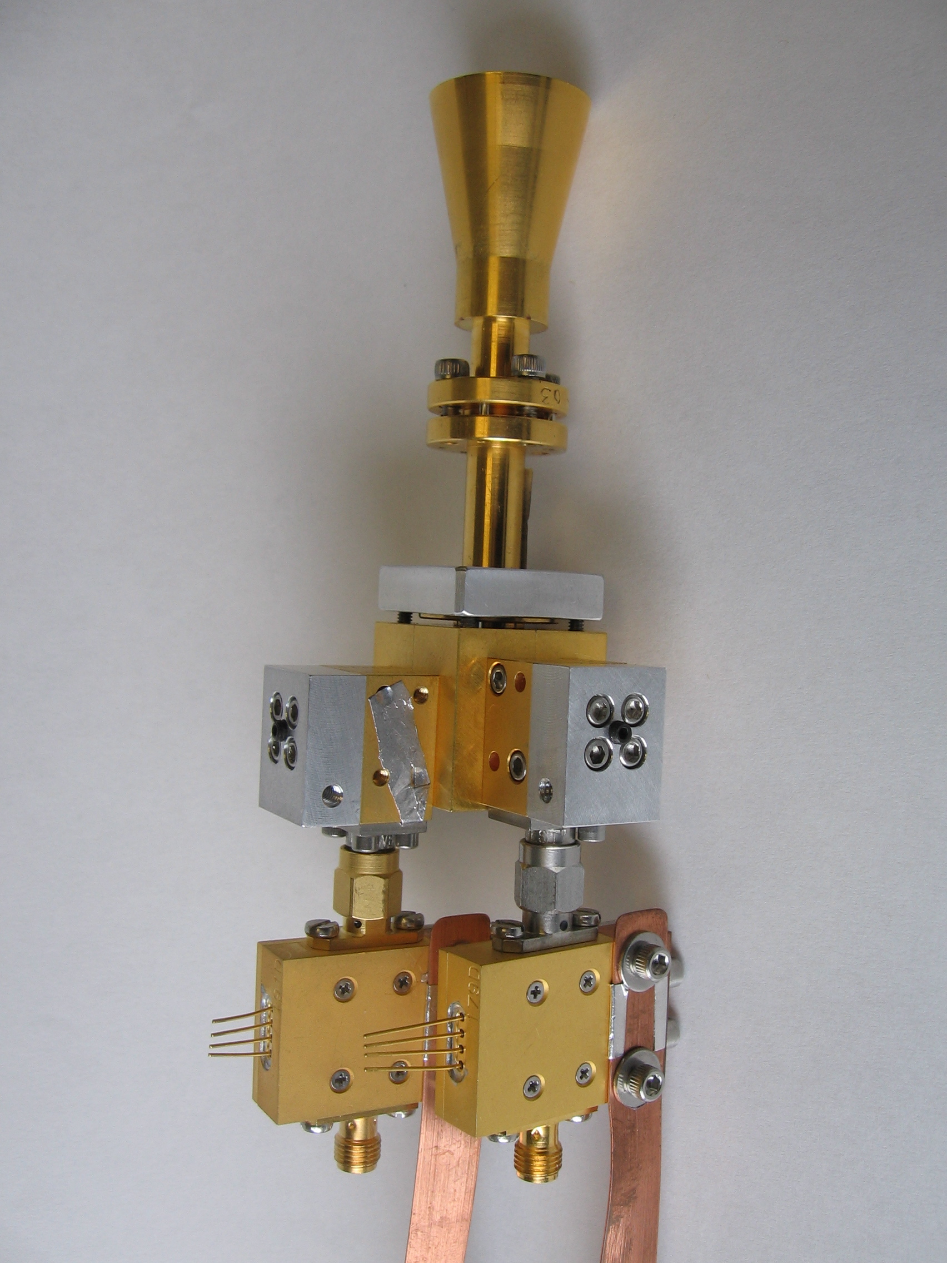
1mm Polarization with CARMA
Feed horn
Polarizer
Orthomode transducer
Mixers
Amplifiers
1 inch
Credit: Dick Plambeck

Slide 37
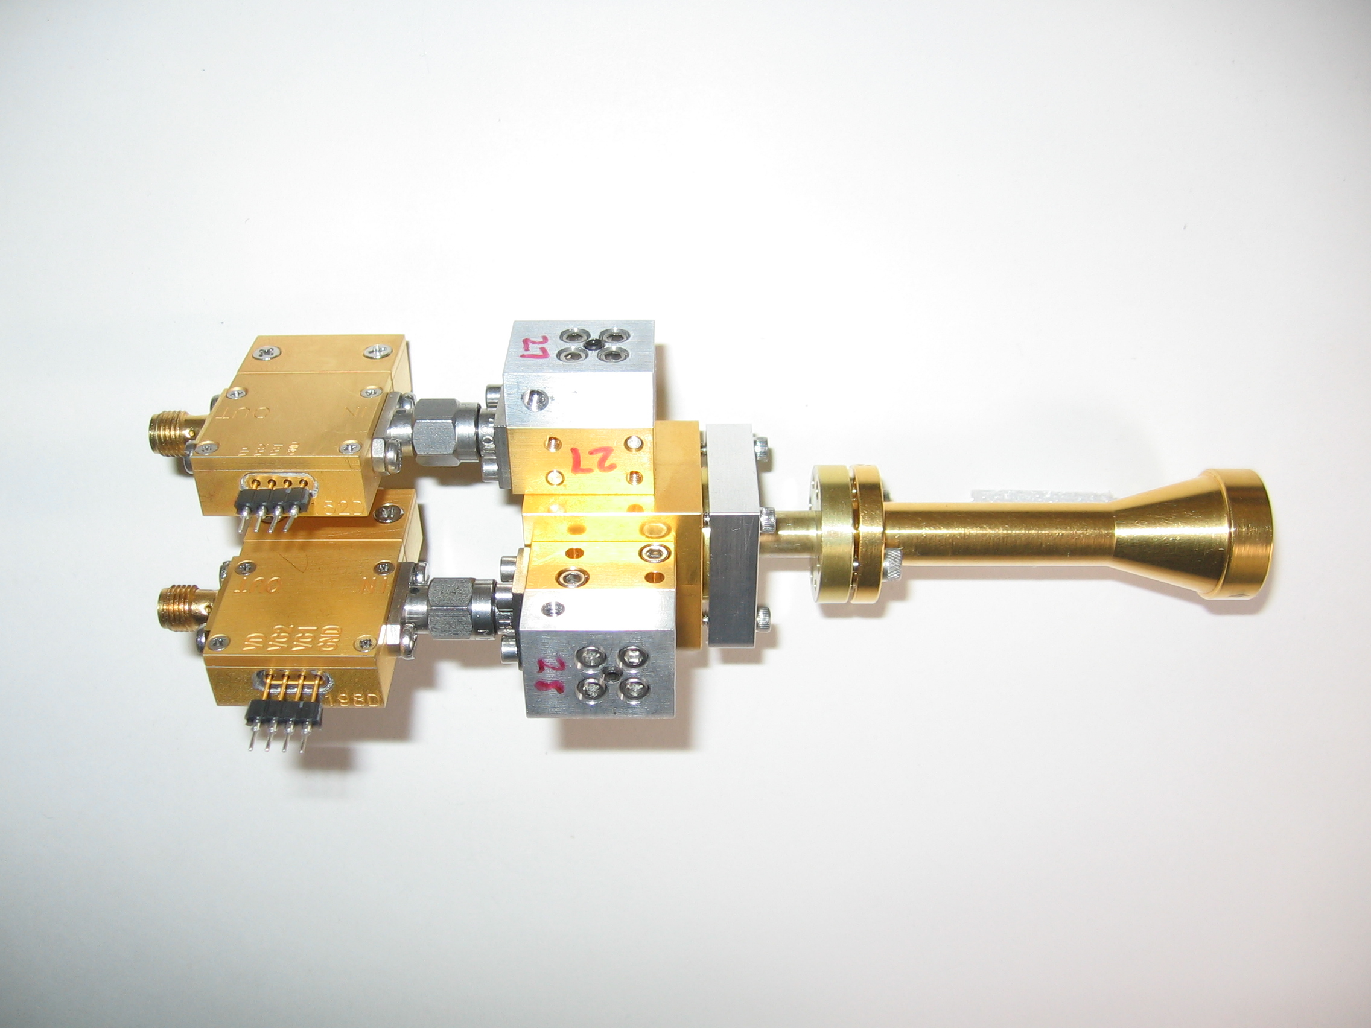
1 mm dual-polarization receivers
SIS mixers
Orthomode transducer
Waveguide circular polarizer
1 inch
WBA13
I.F. amplifiers (1-9 GHz)
Credit: Dick Plambeck
Notes:
-Sensitive to RCP & LCP
-Null experiment: in the absence of linear polarization, you get no RL correlation at any time.
-If you have linear feeds, you have XY correlation sometimes (when the intrinsic polarization is at 45º to your two feeds), and not other times (when it’s along one feed or the other). Thus, to tease out the polarization, you need stable gains

Slide 38
TADPOL survey
35 sources
Triples number of interferometric polarization maps
~300 observing hours
CARMA C, D, & E arrays
1 – 4" resolution
10⨉ higher resolution than CSO & JCMT
Probes intermediate region between ~0.1 pc (single-dish) and ~100 AU (ALMA)
1 mm wavelength
Ideal for dust polarization, as well as CO(2-1) for outflow mapping

Slide 39
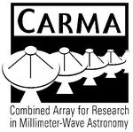












TADPOL collaboration
UC Berkeley
Chat Hull (PI), Dick Plambeck, Mel Wright, Carl Heiles, Geoff Bower
University of Maryland
Marc Pound, Alberto Bolatto, Katherine Jameson,
Lee Mundy
Caltech
Thushara Pillai, John Carpenter, James Lamb,
Nikolaus Volgenau
University of Illinois, Urbana-Champagne
Ian Stephens, Leslie Looney, Woojin Kwon,
Dick Crutcher, Nick Hakobian
Other
Dan Marrone (Arizona), Meredith Hughes (Wesleyan), John Vaillancourt & Göran Sandell (USRA-SOFIA), John Tobin (NRAO), Jason Fiege (Manitoba),
Erica Franzmann (Manitoba), Martin Houde (UWO, Caltech), Brenda Matthews (NRC-CNRC)

Slide 40
TADPOL results
L1157
Notes:
NEARBY SF regions:
-Perseus (NGC 1333, L1448, SVS13): 235 pc (masers in SVS13) → 03:30 LST
-Taurus (DG Tau, L1527): 140 pc → 04:30 LST
-Orion: 400 pc → 05:30 LST
-Serpens: 415 pc → 18:30 LST
-Ophiuchus: 140 pc → 17:00 LST
-Cepheus (L1157): 250 pc → 22:00 LST
-Isolated (B335, Bok globule): 250 pc

Slide 41
TADPOL results
NGC 1333-IRAS 4A
NGC 1333-IRAS 2A
Notes:
NEARBY SF regions:
-Perseus (NGC 1333, L1448, SVS13): 235 pc (masers in SVS13) → 03:30 LST
-Taurus (DG Tau, L1527): 140 pc → 04:30 LST
-Orion: 400 pc → 05:30 LST
-Serpens: 415 pc → 18:30 LST
-Ophiuchus: 140 pc → 17:00 LST
-Cepheus (L1157): 250 pc → 22:00 LST
-Isolated (B335, Bok globule): 250 pc

Slide 42
TADPOL results
NGC 1333-IRAS 4B
Ser-emb 8
Notes:
NEARBY SF regions:
-Perseus (NGC 1333, L1448, SVS13): 235 pc (masers in SVS13) → 03:30 LST
-Taurus (DG Tau, L1527): 140 pc → 04:30 LST
-Orion: 400 pc → 05:30 LST
-Serpens: 415 pc → 18:30 LST
-Ophiuchus: 140 pc → 17:00 LST
-Cepheus (L1157): 250 pc → 22:00 LST
-Isolated (B335, Bok globule): 250 pc

Slide 43
Outflow vs. B-field: distribution
Simulation: outflows & B-fields aligned within a 20º cone (tightly aligned)
Simulation: outflows & B-fields are randomly oriented
Cumulative Distribution Function (CDF)
Simulation: outflows & B-fields aligned between 70–90º (preferentially misaligned)
KS-test results:
20º cone ruled out ( p-value ~ 10⁻⁹ )
Misaligned ( 0.79 ) and random ( 0.64 ) cannot be ruled out
Hull+ 2012, submitted to ApJ
Preprint: arXiv:1212.0540
(Projected) angle between outflow & B-field (deg)

Slide 44
Conclusions
Introduced radio astronomy, radio telescopes, and star formation
B-fields are either preferentially misaligned (perp.) or randomly aligned with respect to outflows at the
~1000 AU scale
Thus, circumstellar disks are misaligned with fields in the cores from which they formed
TADPOL results: arXiv:1212.0540
TADPOL survey (CARMA key project): tadpol.astro.illinois.edu
Questions? Contact Chat Hull: chat@astro.berkeley.edu
Notes:
Other TADPOL future possibilities:
Intrinsic modeling of B-fields in cores (Fiege)
Constraints on B-fields in protoplanetary disks (Hughes)
Turbulence power spectra (Houde)
Larger scale background-star maps (Mimir, Jameson/Pillai/Clemens)

Slide 45
Fin

